Slide 1
JAVA PROJECT
Voter ID Registration
Submitted By: kapil sharma And Akshay tomar
Submitted to: Mr. Madhukar Yadav sir

Slide 2
USED METHODS
Jframe
Set bounds
Set visible
Jpanel
Jlabel
Add();
Settext();
Setbounds();
setFonts();
Actionlistener()

Slide 3
PREVIOUS IN CONTINUATION
JTEXTFIELD
FILEHANDLING
WRITE();
CREATENEWFILE();
SETFOREGROUND();
SETBACKGROUND();

Slide 4
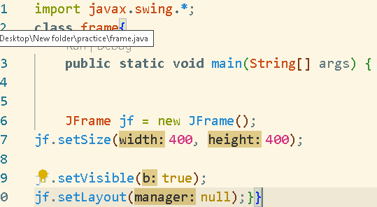
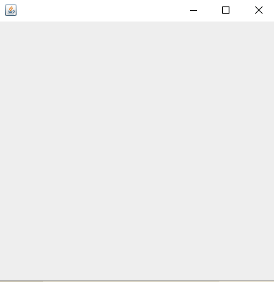
JFRAME
code
output

Slide 5
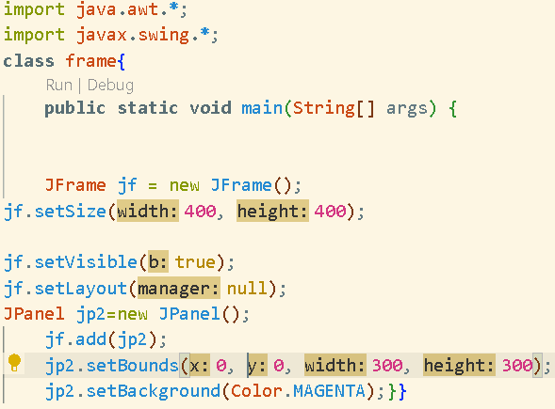
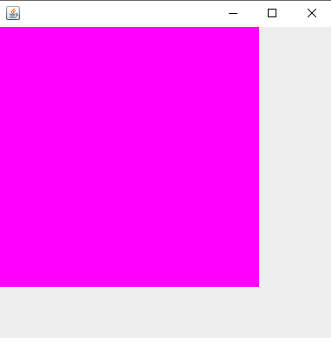
JPANEL
code
output

Slide 6
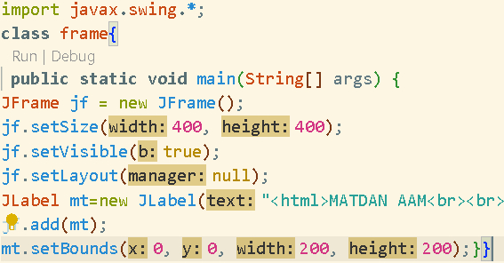
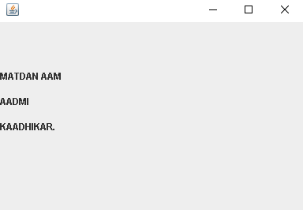
JLABEL
code
output

Slide 7
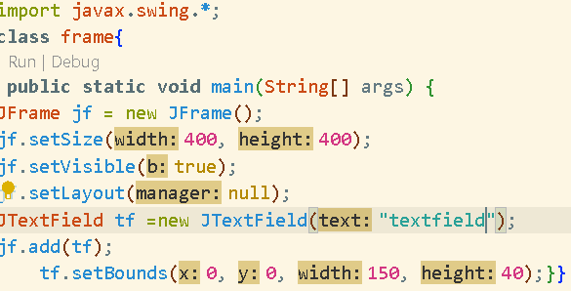
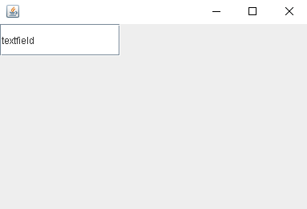
JTEXTFIELD
code
output

Slide 8
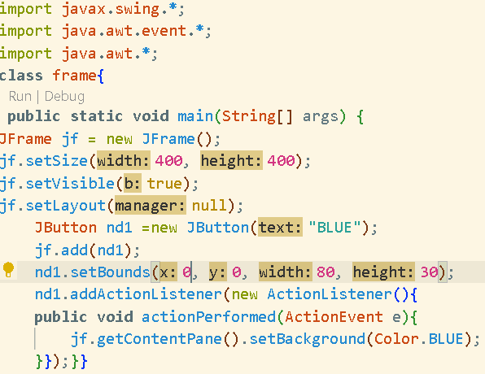
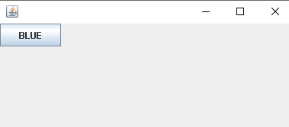
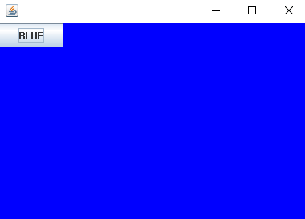
ACTION LISTENER
code
output
After click on blue button

Slide 9
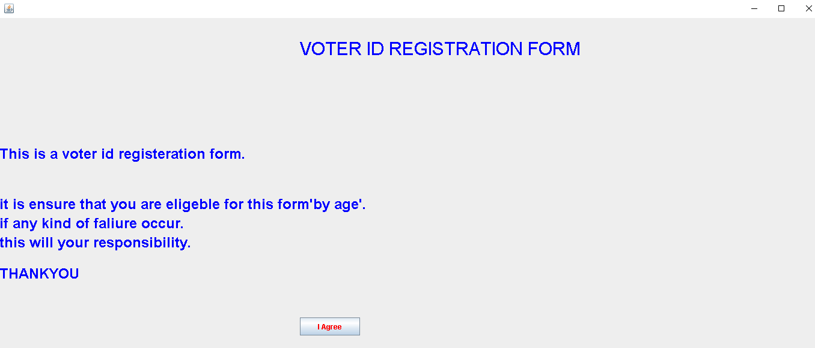
FINAL OUTPUT OF PROJECT

Slide 10
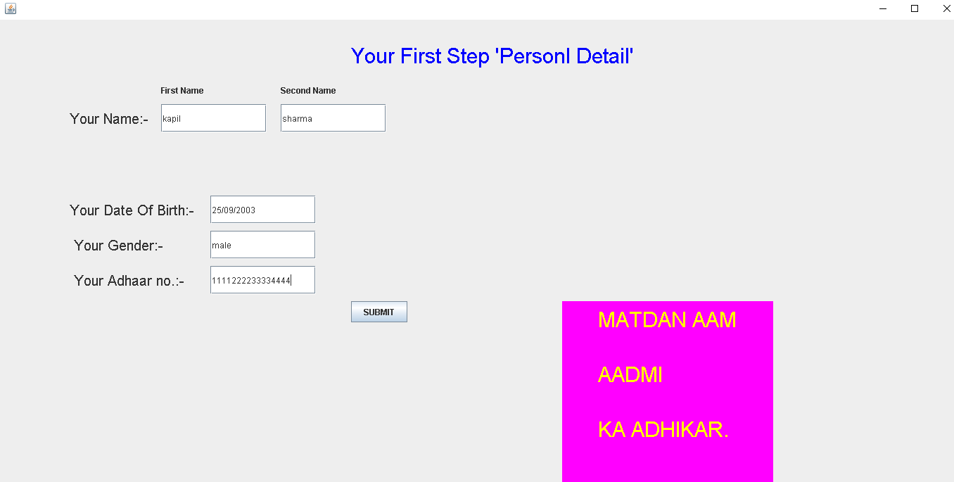
Continue previous slide

Slide 11
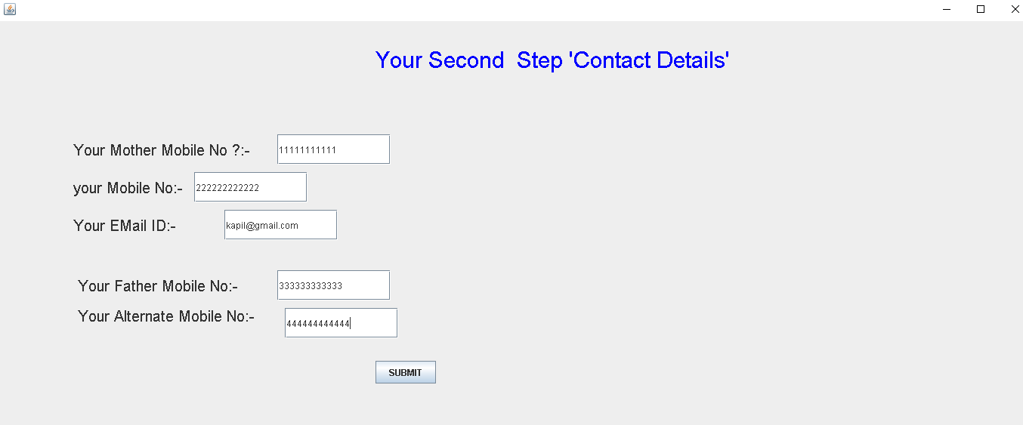
Continue previous slide

Slide 12
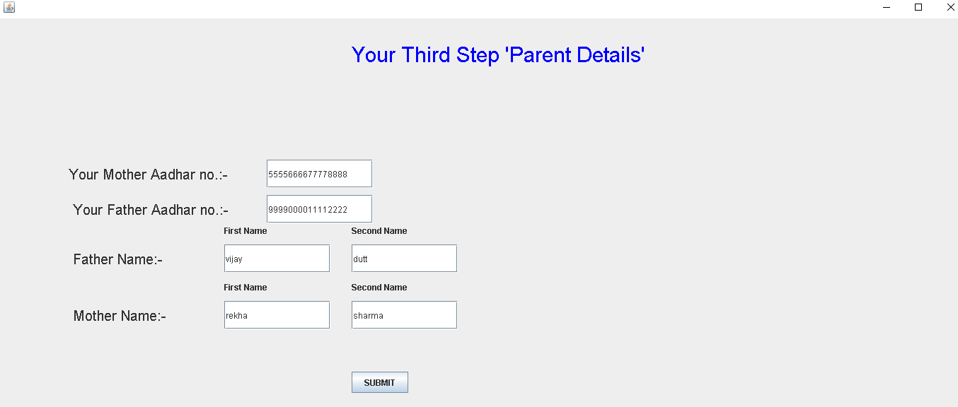
Continue previous slide

Slide 13
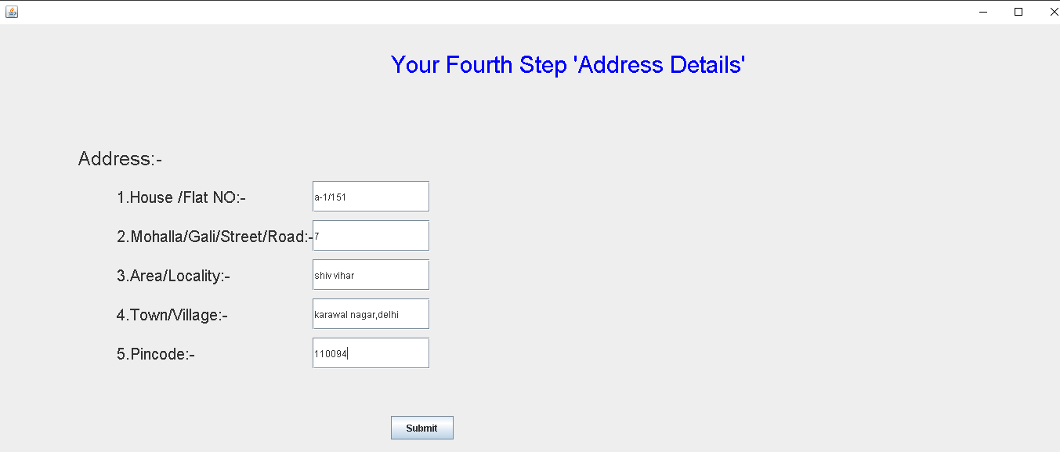
Continue previous slide

Slide 14
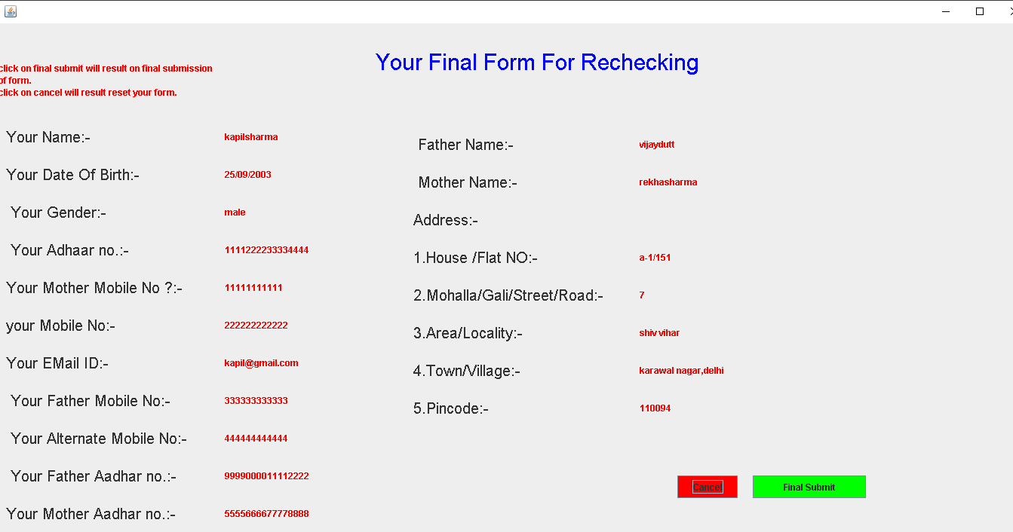
Continue previous slide

Slide 15
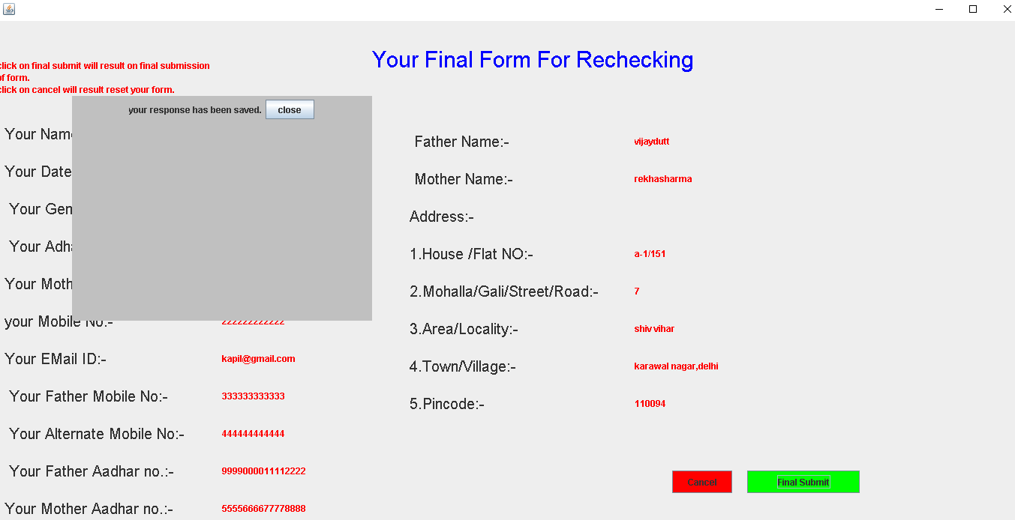
Continue previous slide

Slide 16
Continue previous slide
PROJECT
COMPLETED

Slide 17
Question and answers

Slide 18
THANKYOU

